Slide 1
IoT Security
A Survey on IoT Security: Application Areas, Security Threats, and Solution Architectures
VIKAS HASSIJA¹, VINAY CHAMOLA ², VIKAS SAXENA¹, DIVYANSH JAIN¹, PRANAV GOYAL¹, AND BIPLAB SIKDAR ³, (Senior Member, IEEE

Slide 3


IoT has special security challenges such as privacy issues, authentication issues, management issues, storage issues and so on.

Slide 5
Security Critical Application Areas of IoT
Smart Cities: Smart homes, smart traffic management, smart lighting, smart disaster management, smart utilities etc
Smart Environment: fire detection in forests, monitoring the snow levels, preventing landslides, early detection of earth quakes, pollution monitoring etc.
Smart metering and smart grids
Security and emergencies
Smart retail: storage condition monitoring, product tracking etc.
Smart agriculture and animal farming
Home automation

Slide 8
Security Issues at sensing layers
Node Capturing: IoT applications comprise of several low power nodes such as sensors and actuators. These nodes are vulnerable to a variety of attacks by the adversaries. The attackers may try to capture or replace the node in the IoT system with a malicious node. The new node may appear to be the part of the system but is controlled by the attacker. This may lead to compromising the security of the complete IoT application.
Malicious Code Injection Attack: The attack involves the attacker injecting some malicious code in the memory of the node. Generally, the firmware or software of IoT nodes are upgraded on the air, and this gives a gateway to the attackers to inject malicious code. Using such malicious code, the attackers may force the nodes to perform some unintended functions or may even try to access the complete IoT system.

Slide 9
False Data Injection Attack: Once the node is captured, the attacker may use it to inject erroneous data onto the IoT system. This may lead to false results and may result in malfunctioning of the IoT application. The attacker may also use this method to cause a DDoS attack.
Side-Channel Attacks (SCA): Apart from direct attacks on the nodes, various side-channel attacks may lead to leaking of sensitive data. The microarchitectures of processors, electromagnetic emanation and their power consumption reveal sensitive information to adversaries. Side channel attacks may be based on power consumption, laser-based attacks, timing attacks or electromagnetic attacks. Modern chips take care of various countermeasures to prevent these side-channel attacks while implementing the cryptographic modules.

Slide 10
Eavesdropping and Interference: IoT applications often consist of various nodes deployed in open environments. As a result, such IoT applications are exposed to eavesdroppers. The attackers may eavesdrop and capture the data during different phases like data transmission or authentication.
Sleep Deprivation Attacks: In such type of attacks the adversaries try to drain the battery of the low-powered IoT edge devices. This leads to a denial of service from the nodes in the IoT application due to a dead battery. This can be done by running infinite loops in the edge devices using malicious code or by artificially increasing the power consumption of the edge devices.
Booting Attacks: The edge devices are vulnerable to various attacks during the boot process. This is because the inbuilt security processes are not enabled at that point. The attackers may take advantage of this vulnerability and try to attack the node devices when they are being restarted. As edge devices are typically low powered and at times go through sleep-wake cycles, it is thus essential to secure the boot process in these devices.

Slide 11
SECURITY ISSUES AT NETWORK LAYER
Phishing Site Attack: Phishing attacks often refer to attacks where several IoT devices can be targeted by a minimal effort put by the attacker. The attackers expect that at least few of the devices will become a victim of the attack. There is a possibility of encountering phishing sites in the course of users visiting web pages on the Internet. Once the user’s account and password are compromised, the whole IoT environment being used by the user becomes vulnerable to cyber attacks. The network layer in IoT is highly vulnerable to phishing sites attacks [26].
Access Attack: Access attack is also referred to as advanced persistent threat (APT). This is a type of attack in which an unauthorized person or an adversary gains access to the IoT network. The attacker can continue to stay in the network undetected for a long duration. The purpose or intention of this kind of attack is to steal valuable data or information, rather than to cause damage to the network. IoT applications continuously receive and transfer valuable data and are therefore highly vulnerable to such attacks [27].

Slide 12
DDoS/DoS Attack: In this kind of attacks, the attacker floods the target servers with a large number of unwanted requests. This incapacitates the target server, there by disrupting services to genuine users. If there are multiple sources used by the attacker to flood the target server, then such an attack is termed as DDoS or distributed denial of service attack. Such attacks are not specific to IoT applications, but due to the heterogeneity and complexity of IoT networks, the network layer of the IoT is prone to such attacks. Many IoT devices in IoT applications are not strongly configured, and thus become easy gateways for attackers to launch DDoS attacks on the target servers. The Mirai botnet attack as used this vulnerability and blocked various servers by constantly propagating requests to the weakly configured IoT devices.

Slide 13
Data Transit Attacks: IoT applications deal with a lot of data storage and exchange. Data is valuable, and therefore it is always the target of hackers and other adversaries. Data that is stored in the local servers or the cloud has a security risk, but the data that is in transit or is moving from one location to another is even more vulnerable to cyber attacks. In IoT applications, there is a lot of data movement between sensors, actuators, cloud, etc. Different connection technologies are used in such data movements, and therefore IoT applications are susceptible to data breaches.
Routing Attacks: In such attacks, malicious nodes in an IoT application may try to redirect the routing paths during data transit. Sinkhole attacks are a specific kind of routing attack in which an adversary advertises an artificial shortest routing path and attracts nodes to route traffic through it. A worm-hole attack is another attack which can become serious security threat if combined with other attacks such as sinkhole attacks. A warm-hole is an out of band connection between two nodes for fast packet transfer. An attacker can create a warm-hole between a compromised node and a device on the internet and try to bypass the basic security protocols in an IoT application.

Slide 14
SECURITY ISSUES AT MIDDLEWARE LAYER
Man-in-the-Middle Attack: The MQTT protocol uses publish-subscribe model of communication between clients and subscribers using the MQTT broker, which effectively acts as a proxy. This helps in decoupling the publishing and the subscribing clients from each other and messages can be sent without the knowledge of the destination. If the attacker can control the broker and become a man-in-the-middle, then he/she can get complete control of all communication without any knowledge of the clients.
SQL Injection Attack: Middleware is also susceptible to SQL Injection (SQLi) attacks. In such attacks, attacker can embed malicious SQL statements in a program [30], [31]. Then, the attackers can obtain private data of any user and can even alter records in the database [32]. Open Web Application Security Project (OWASP) has listed SQLi as a top threat to web security in their OWASP top 10 2018 document [33].

Slide 15
Signature Wrapping Attack: In the web services used in the middleware, XML signatures are used. In a signature wrapping attack, the attacker breaks the signature algorithm and can execute operations or modify eavesdropped message by exploiting vulnerabilities in SOAP (Simple Object Access Protocol).
Cloud Malware Injection: In cloud malware injection, the attacker can obtain control, inject malicious code or can inject a virtual machine into the cloud. The attacker pretends to be a valid service by trying to create a virtual machine instance or a malicious service module. In this way, the attacker can obtain access to service requests of the victim’s service and can capture sensitive data which can be modified as per the instance.
Flooding Attack in Cloud: This attack works almost the same as DoS attack in the cloud and affects the quality of service (QoS). For depleting cloud resources, the attackers continuously send multiple requests to a service. These attacks can have a big impact on cloud systems by increasing the load on the cloud servers.

Slide 16
SECURITY ISSUES AT GATEWAYS
Secure On-boarding: When a new device or sensor is installed in an IoT system, it is imperative to protect encryption keys. Gateways act as an intermediary between the new devices and the managing services, and all the keys pass through the gateways. The gateways are susceptible to man-in-the-middle attacks and eavesdropping to capture the encryption keys, especially during the on-boarding process.
Extra Interfaces: Minimizing the attack surface is an important strategy that needs to be kept in mind while installing the IoT devices. Only the necessary interfaces and protocols should be implemented by an IoT gateway manufacturer. Some of the services and functionalities should be restricted for end-users to avoid backdoor authentication or information breach.

Slide 17
End-to-End Encryption: True end-to-end application layer security is required to ensure the confidentiality of the data. The application should not let anyone other than the unique recipient to decrypt the encrypted messages. Although Zigbee and Zwave protocols support encryption, this is not end-to-end encryption, because, in order to translate the information from one protocol to another, the gateways are required to decrypt and re-encrypt the messages. This decryption at the gateway level makes the data susceptible to data breaches.
Firmware updates: Most IoT devices are resource constrained, and therefore they do not have an user interface or the computation power to download and install the firmware updates. Generally, gateways are used to download and apply the firmware updates. The current and new version of the firmware should be recorded, and validity of the signatures should be checked for secure firmware updates.

Slide 18
SECURITY ISSUES AT APPLICATION LAYER
Data Thefts: IoT applications deal with lot of critical and private data. The data in transit is even more vulnerable to attacks than data at rest, and in IoT applications, there is a lot of data movement. The users will be reluctant to register their private data on IoT applications if these applications are vulnerable to data theft attacks. Data encryption, data isolation, user and network authentication, privacy management, etc. are some of the techniques and protocols being used to secure IoT applications against data thefts.
Access Control Attacks: Access control is authorization mechanism that allows only legitimate users or processes to access the data or account. Access control attack is a critical attack in IoT applications because once the access is compromised, then the complete IoT application becomes vulnerable to attacks.

Slide 19
Service Interruption Attacks: These attacks are also referred to as illegal interruption attacks or DDoS attacks in existing literature. There have been various instances of such attacks on IoT applications. Such attacks deprive legitimate users from using the services of IoT applications by artificially making the servers or network too busy to respond.
Malicious Code Injection Attacks: Attackers generally go for the easiest or simplest method they can use to break into a system or network. If the system is vulnerable to malicious scripts and misdirections due to insufficient code checks, then that would be the first entry point that an attacker would choose. Generally, attackers use XSS (cross-site scripting) to inject some malicious script into an otherwise trusted website. A successful XSS attack can result in the hijacking of an IoT account and can paralyze the IoT system.

Slide 20
Sniffing Attacks: The attackers may use sniffer applications to monitor the network traffic in IoT applications. This may allow the attacker to gain access to confidential user data if there are not enough security protocols implemented to prevent it [39].
Reprogram Attacks: If the programming process is not protected, then the attackers can try to reprogram the IoT objects remotely. This may lead to the hijacking of the IoT network [40].

Slide 21
IMPROVEMENTS AND ENHANCEMENTS REQUIRED FOR UPCOMING IoT APPLICATIONS
Rigorous penetration testing for IoT devices is necessary to quantify the level of risk involved in deploying these devices in different applications. Based on the risk involved, a priority list can be made and the devices can be deployed appropriately in different applications.
Encryption techniques are being used in IoT system at different layers and protocols. However, there are various levels of encrypt, decrypt, and re-encrypt cycles in the complete system. These cycles make the system vulnerable to attacks. End to end encryption would be a promising solution to prevent different attacks.

Slide 22
Authenticate-always protocols need to be implemented. Whenever a device wants to interact with another device, an authentication process should be implemented. Digital certificates can be a promising solution to provide seamless authentication with bound identities that are tied to cryptographic protocols.
Any IoT security framework being implemented should be tested and confirmed for scalability. The security protocols should not be working only for a limited set of users. The real threats start coming only when the application becomes public and starts being used widely in the public domain. Therefore, proper strategy and planning are required.

Slide 23
A mechanism based on encryption techniques like RSA, SHA256, or hash chains is required to secure the user and environment data from being captured. IoT devices need to be designed in a way that they can transmit the sensed data in a secure and encrypted way. This will help in gaining the trust of the individuals, government agencies and industries in IoT applications.
Since the IoT devices and applications are growing rapidly, an approach needs to be designed to handle the cost and capacity constraints that are expected to be encountered shortly. A paradigm shift from a centralized approach to some decentralized approach might be needed, where devices can automatically and securely communicate with each other. This can help in reducing the cost of managing the applications and can reduce the issues of capacity constraints.

Slide 24
Since most of the IoT applications use cloud services for data storage and retrieval, the risks caused by the cloud should also be considered. Cloud is a public platform used by multiple users and there may be malicious users on the cloud who can be the cause of threat for IoT related data. The data should be stored as ciphertext in the cloud and the cloud should not be allowed to decrypt any ciphertext. This can further enhance data security and can save us from the generic risks of using cloud services [44].
Apart from the challenges from outside entities, there are various scenarios where the sensors in an IoT application start collecting or sending erroneous data. These errors might be easy to handle in case of a centralized architecture but can become a bottleneck in case of an autonomous decentralized architecture. Faulty reading or transmitting of data can lead to undesirable results. Thus, mechanism needs to be identified to validate the data flow, especially in case of a distributed architecture [45].

Slide 25
Since the ultimate goal of all IoT applications is to create an autonomous system that needs minimum human interventions, the use of some artificial intelligence (AI) based techniques or algorithms to secure IoT devices might be useful. This can help in reducing the analysis and communication load on IoT environment [46].
There are various techniques and approaches in the existing literature for securing IoT environments and applications. These solutions may be divided into four categories: (1) blockchain based solutions; (2) fog computing based solutions; (3) machine learning based solutions and (4) edge computing based solution

Slide 26
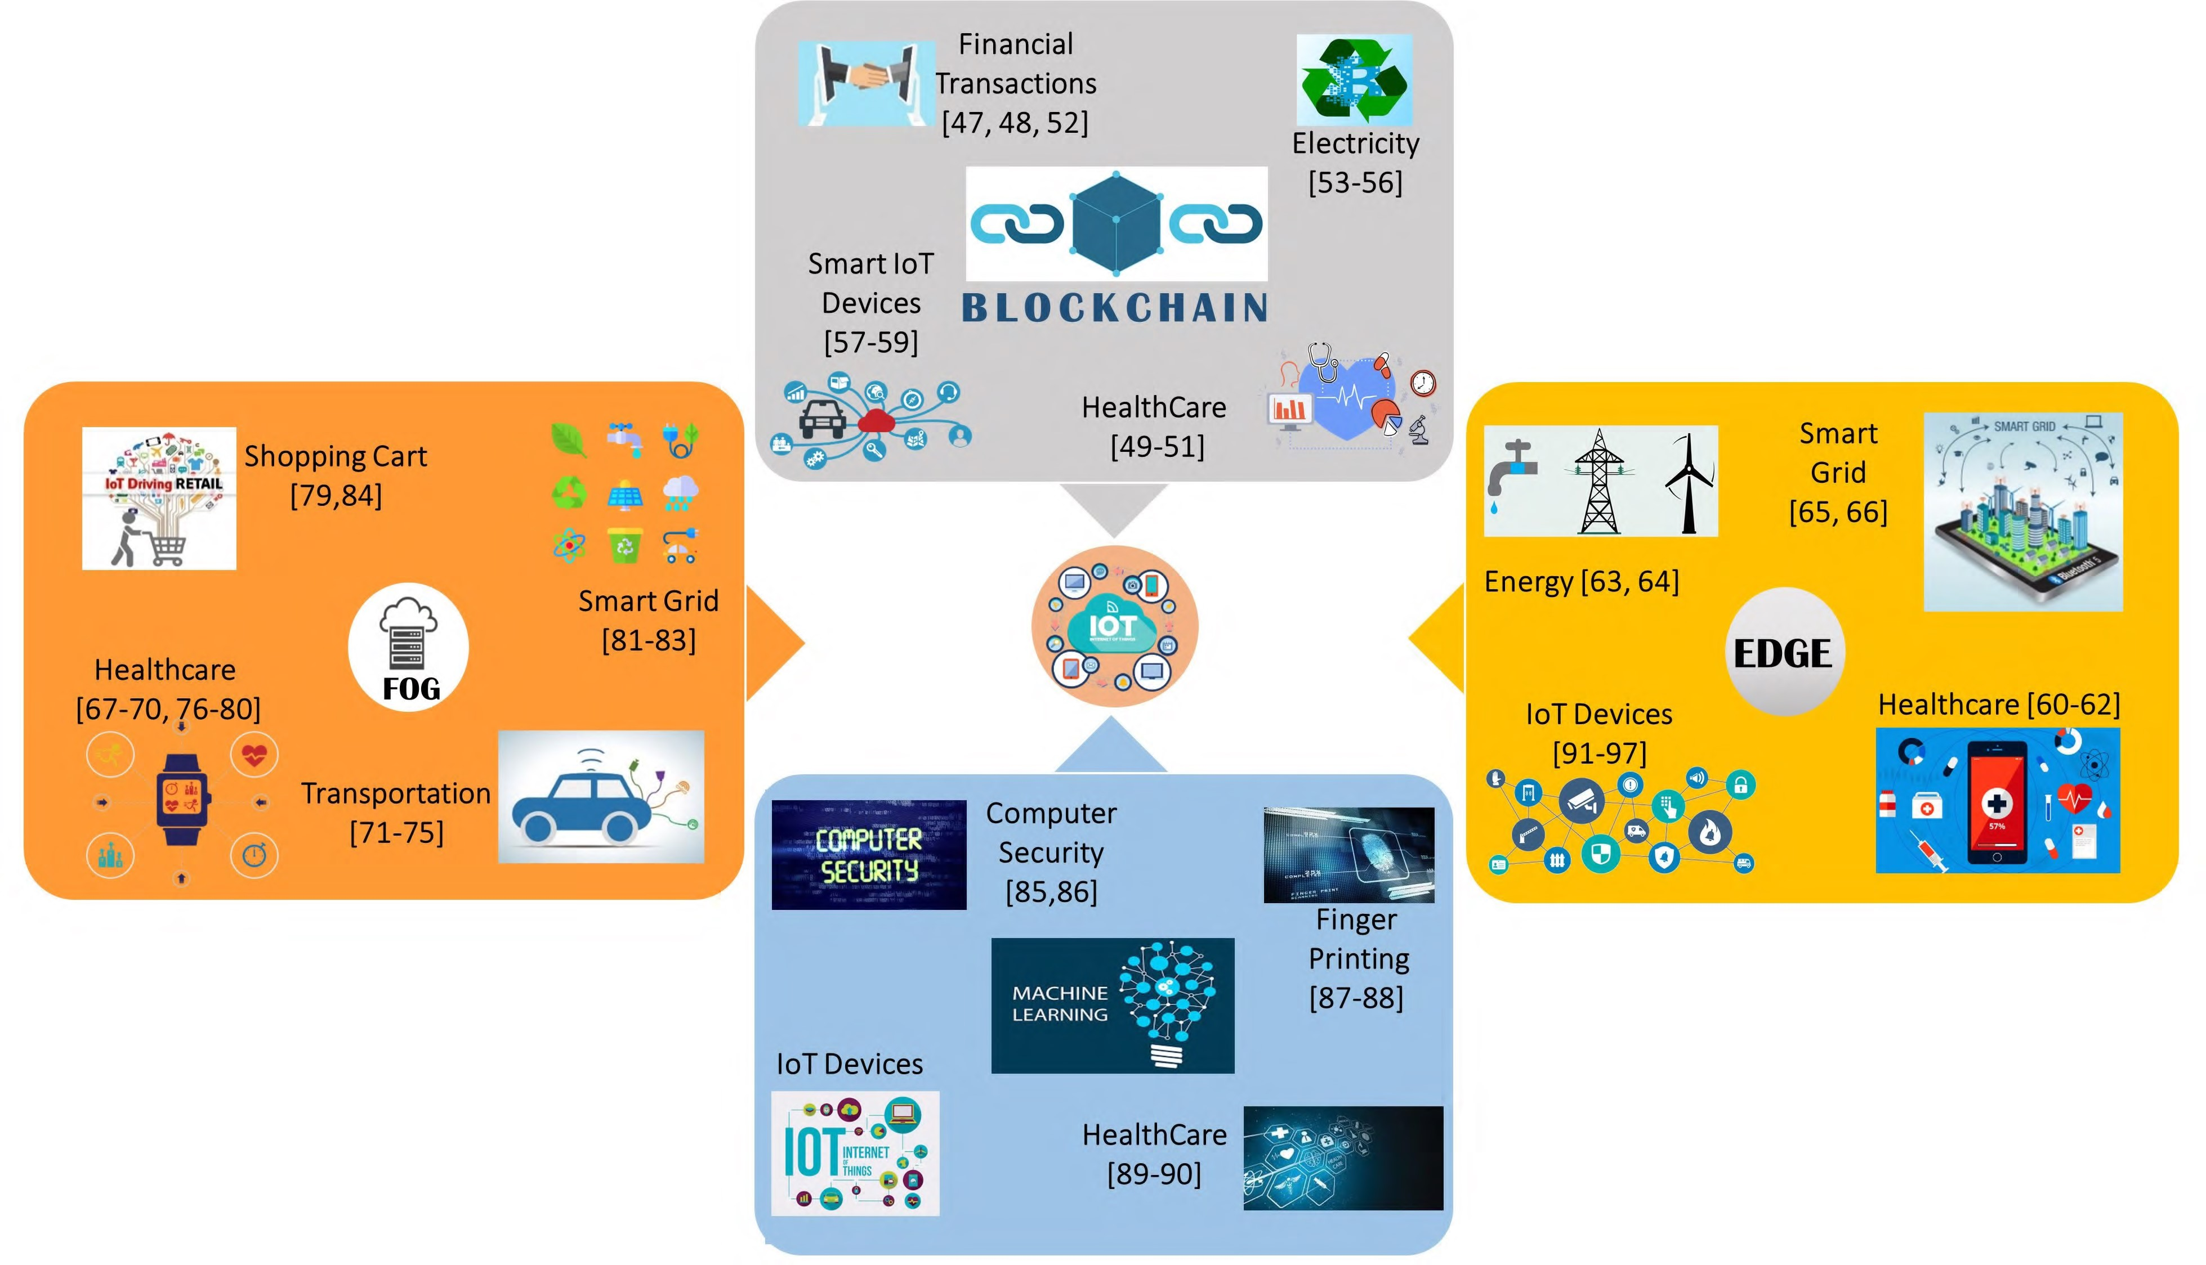

Slide 27
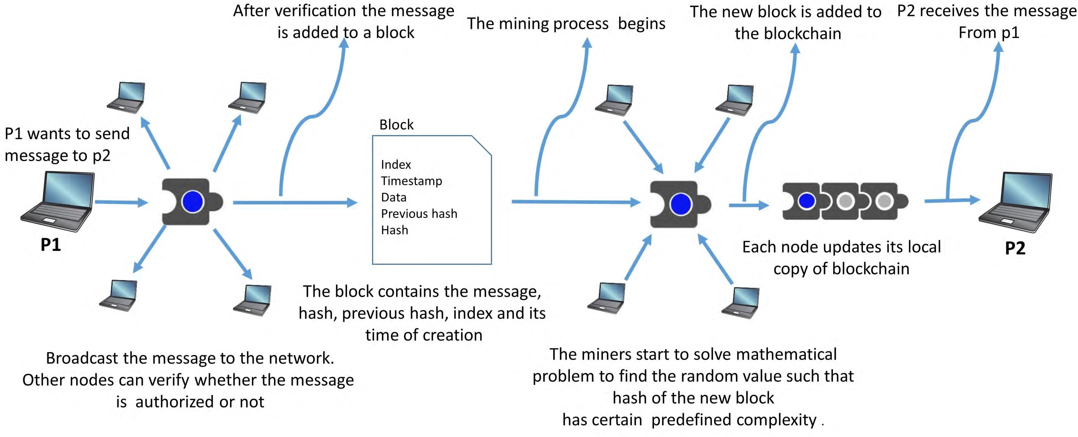
IoT SECURITY USING BLOCKCHAIN

Slide 28
BENEFITS OF BLOCKCHAIN IN IoT
Data coming from IoT devices can be stored in Blockchain: The IoT applications include a large variety of devices connected to each other. These devices are further connected and controlled by other devices. This setup is further connected to the cloud to enable IoT applications to be used from any location. Due to this large space for data movement, blockchain is a promising solution to store the data and prevent it from being misused. Irrespective of the layer in an IoT application, blockchain can act as a suitable solution to store and transmit data.
Distributed nature of blockchain allowing secure data storage: Since the blockchain architecture is distributed in nature, it can avoid the risk of being a single point of failure as is faced by various IoT applications based on the cloud. Irrespective of the distance between the devices, the data generated by them can be easily stored on the blockchain in a secure manner [112].

Slide 29
Data encryption using the hash key and verified by miners: In blockchain, only the 256-bit hash key for the data can be stored, rather than storing the actual data. The actual data can be stored on the cloud and the hash key can be mapped with the original data. If there is any change in the data, the hash of the data will change. This makes the data secure and private. The size of blockchain will also not get affected by the size of the data as only the hash values are stored in the chain. Only the intended parties, who are authorized to use that data can access the data from the cloud using the hash of the data. Every set of data being stored on blockchain is properly verified by different miners in the network, and therefore the probability of storing corrupt data from the devices reduces by using blockchain as a solution.
Prevention from data loss and spoofing attacks: In spoofing attacks on IoT applications, a new adversary node enters into the IoT network and starts imitating to be the part of the original network. By spoofing, the adversary can easily capture, observe or inject data in the network. Blockchain acts as a promising solution to prevent such attacks. Each legitimate user or device is registered on blockchain, and devices can easily identify and authenticate each other without the need for central brokers or certification authorities [113]. Being low powered in nature, IoT devices inherit the risk of losing data. There might be cases where due to some external environmental issues the data is lost by both the sender and the receiver. Use of blockchain can prevent such losses as once the block is added in the chain there is no way to remove it [114].

Slide 30
Blockchain to prevent unauthorized access: Many IoT applications involve a lot of frequent communication between various nodes. The communication in blockchain takes place using the public and private keys, and therefore only the intended party or node can access the data. Even if the unintended party is able to access the data, the contents of the data will be incomprehensible as the data is encrypted with keys. Therefore, the blockchain data structure tries to handle various security issues faced by IoT applications.
Elimination of centralized cloud servers: Blockchain can enhance the security of IoT systems because it ultimately eliminates the centralized cloud servers and makes the network peer-to-peer. Centralized cloud servers are the prime target of the data thieves. Using blockchain, the data will be distributed among all the nodes of the network and will be encrypted using a cryptographic hash function.

Slide 31
Challenges in IoT and possible blockchain solution.

Slide 32
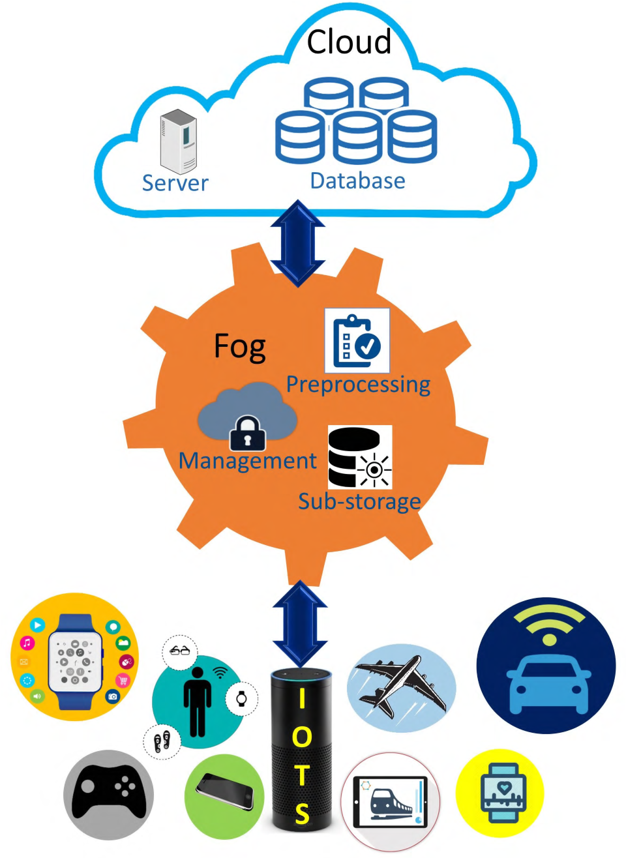
IoT SECURITY USING FOG COMPUTING
FOG COMPUTING ARCHITECTURE: Fog computing reduces the data traffic between cloud and network edge by 90% and average response time for a user by 20% when compared with cloud-only model

Slide 33
SOLUTIONS PROVIDED BY FOG COMPUTING TO OVERCOME IoT SECURITY THREATS
Man-in-the-middle attack: Fog acts as a security layer between end-user and cloud or IoT system. All threats or attacks on the IoT systems need to pass through the fog layer in between, and this layer can identify and mitigate unusual activities before they are passed to the system.
Data transit attacks: Data storage and management is much better if performed on the secure fog nodes, as compared to the IoT devices. Data will be better protected if it is stored on the fog nodes as compared to storing the data on the end-user devices. Fog nodes also help in making the user data more available.

Slide 34
Eavesdropping: Using fog nodes, the communication takes place between the end-user and the fog node only, rather than routing the information through the entire network. The chances of an adversary trying to eavesdrop reduces a lot because the traffic on the network is reduced.
Resource-constraint issues: Most of the IoT devices are resource constrained and the attackers take advantage of this fact. They try to damage the edge devices and use them as the weak links to enter the system. Fog nodes can support the edge devices and can prevent them from being affected by such attacks. A nearby fog node can perform the more sophisticated security functions necessary for protection.

Slide 35
Incident response services: Fog nodes can be programmed to provide real-time incident response services. Fog nodes can generate a flag to the IoT system or the end users as soon as they encounter a suspicious data or request. Fog computing allows for malware detection and problem resolution in transit. In many critical applications, it might not be possible to stop the entire system to resolve malware incidences. Fog node scan help in such resolutions while the system is up and running.

Slide 36
SECURITY CHALLENGES AND SOLUTIONS IN FOG LAYER.

Slide 37
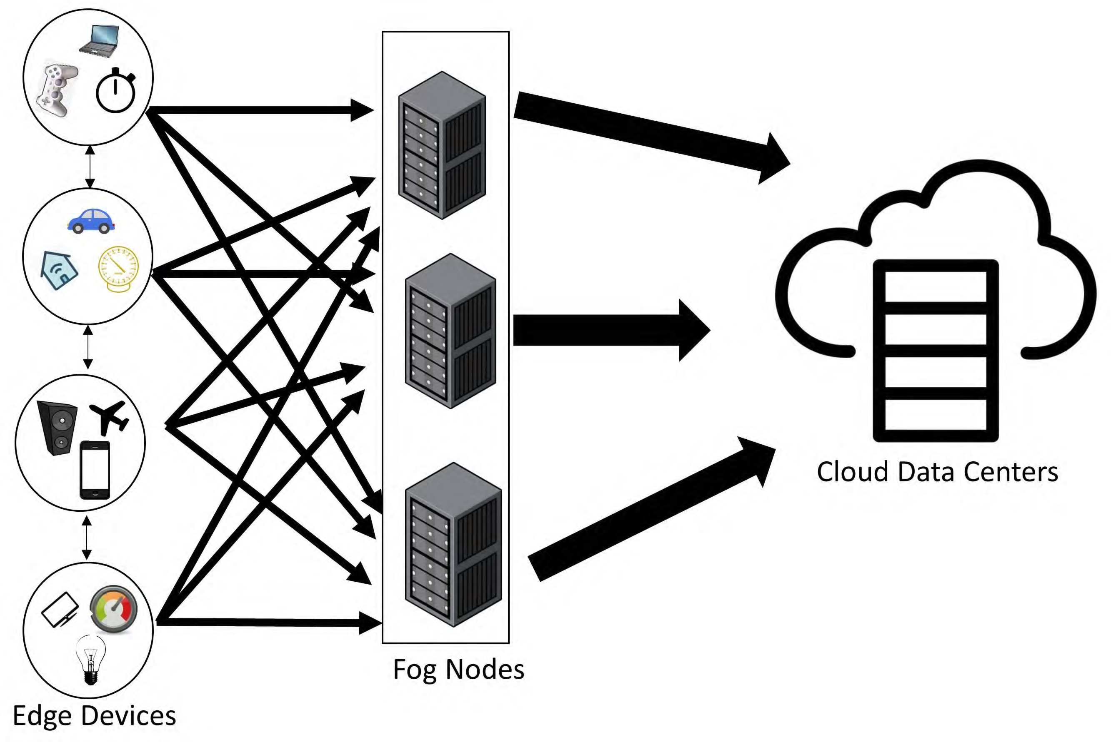
IoT SECURITY USING EDGE COMPUTING

Slide 38
Data Breaches: In edge computing, all the data is stored and processed within the device or local network. There is no movement of the data from the data originator to the processor. This prevents the data from being in transit and thereby prevents the risk of data thefts and data breaches. In fog computing there is some movement of data from a device to fog layer and adversaries can take advantage of this movement.
Data Compliance Issues: Many countries have strict regulatory acts to prevent data movement outside their boundaries, e.g., European Union’s GDPR (General Data Protection Regulation). Using edge computing, organizations can keep the data within their borders and ensure compliance with data sovereignity laws.

Slide 39
Safety Issues: With the increase in the deployment of cyber-physical systems, security and safety are considered as integral issues. If there is even a little delay in responses, then that may lead to physical safety issues. For example, if the sensors in a car predict that a crash is about to happen, then the airbags have to be deployed immediately. If the sensors completely rely on sending all the data to the cloud and waiting for the response from the cloud to perform any action, then that may be too late to prevent injuries or loss of life. Surveillance cameras can also be empowered using edge computing and they can themselves analyze the anomalies and can send the summarized and suspected data to the data centers to achieve faster response times.
Bandwidth Issues: IoT application generate a lot of data at very high rate. Most of this data is raw and of relatively low-value. Sending all the data to the cloud involves a lot of bandwidth cost as well, along with the security challenges of data movement. If edge computing is used, then a lot of data cleaning and aggregation can be done at the edge nodes and only the summarized data, if required, needs to be sent to the cloud.

Slide 40
Future research directions
The edge devices are most resource constrained devices in the IoT and are therefore uniquely vulnerable to attacks. Penetration studies show that while it takes very little power to implement best practice security for the edge nodes, they are still highly vulnerable to a variety of malicious attacks.
The gateways between different layers in the IoT system need to be secured. Gateways provide an easy entry point for the attackers into the IoT system. End to end encryption, rather than specific encryption techniques for specific protocols would be a promising solution to secure the data passing through the gateways. The data should be decrypted only at the intended destination and not at the gateways for protocol translation.
Inter-fog sharing of resources is one of the areas where further work needs to be done. As of now, when the fog layer is unable to process the requests due to heavy load, the requests are forwarded to the cloud. There can be resource sharing between neighboring fog layers to prevent unwanted requests to be transferred to the cloud.

Slide 41
The current blockchain architecture is highly limited in terms of the number of nodes in permissioned networks and in terms of throughput in permissionless networks. Various consensus algorithms are being designed to support high throughput along with a large number of nodes or users.
Fog layer can be made more intelligent using various ML and AI techniques. Fog layer must be able to decide the duration for which the data in the fog should be retained and when the data should be discarded or shifted to the cloud for prolonged storage.
More efficient and reliable consensus mechanisms can be designed to reach consensus among the nodes along with preventing rampant use of computation power. The current consensus algorithms are highly resource hungry and less efficient.

Slide 42
The tamper-proof feature of blockchain is ending up into a collection of a lot of garbage data and addresses. There is a lot of invalid data that is never deleted like the addresses of the destructed smart contracts. This affects the performance of the overall application and better ways need to be designed to efficiently handle the garbage data in the blockchain.
Data analysis in near real-time and in the proximity of the IoT node is crucial for successful deployment of IoT applications. Various ML-based algorithms can be designed to analyze the data in the node itself to prevent the data transit for analysis. This can further enhance the security of the application by preventing data movement

